Slide 1
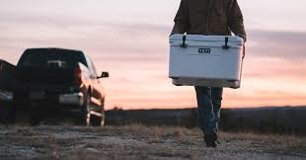
YETI: Brand Analysis
27 April 2020
The Cooler Crew (Group 6): Alex Mendelson, Ben Lewer, Faith Flynn, Kayla Shan Koh

Slide 2

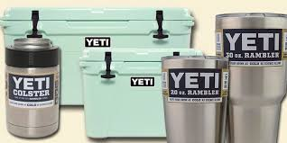
The Brand

Slide 3
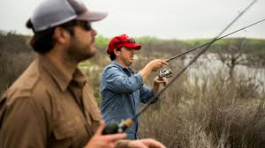
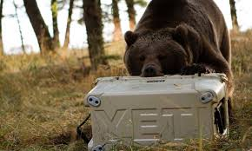
The Company
YETI was started by brothers Roy and Ryan Seiders in 2006
Created high-quality coolers and drinkware to withstand the forces of nature
Never claiming to have the lowest price, but always claiming to be the best price for the high quality
Highly active in the outdoors community--making partnerships with popular organizations and outdoors figureheads

Slide 4
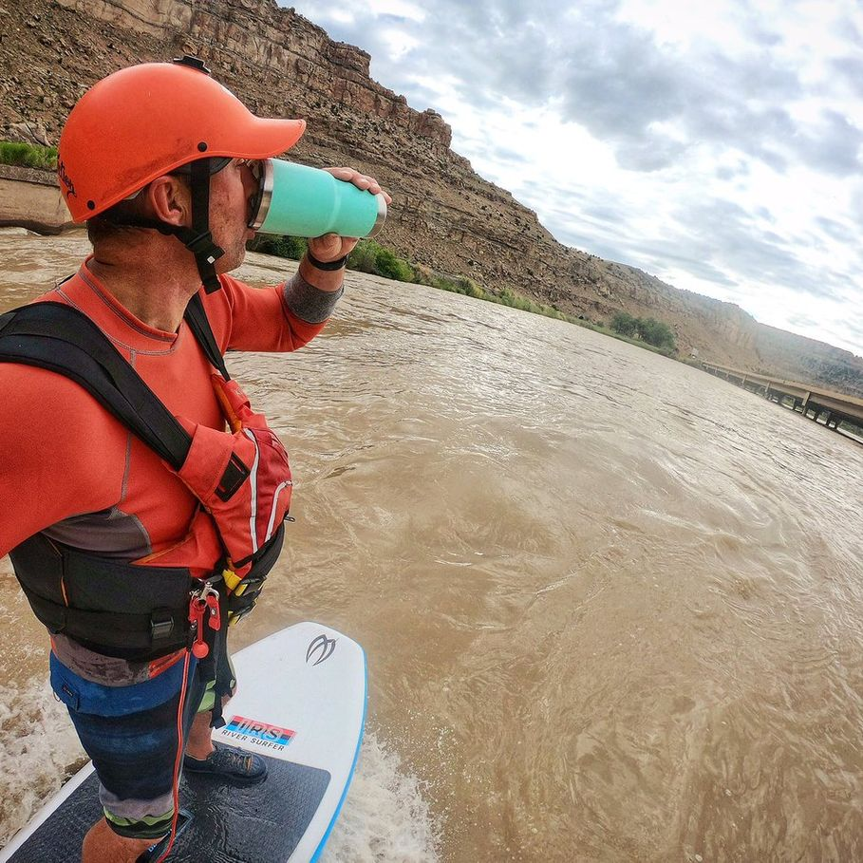
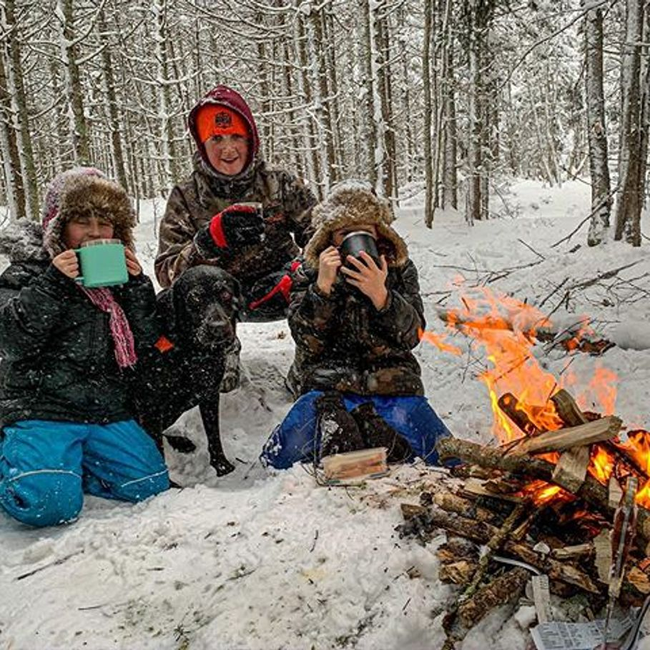
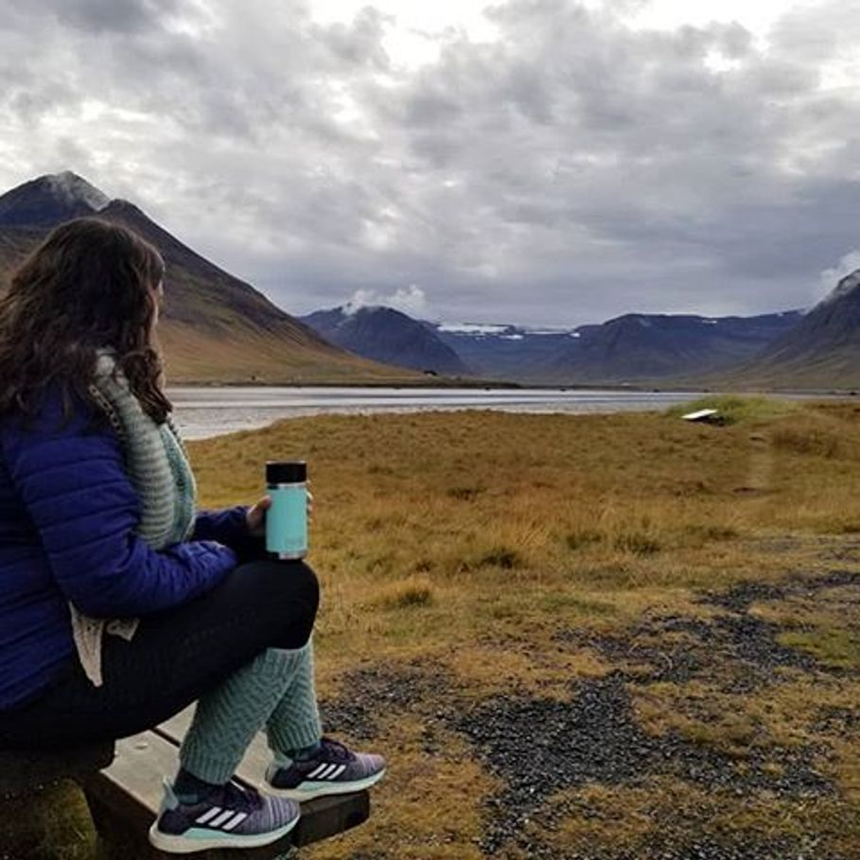
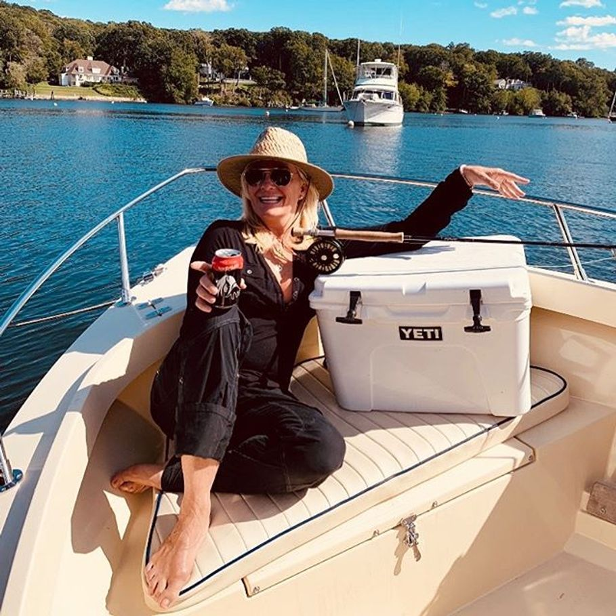
The Consumer
Original target:
Hardcore outdoorsmen including fishermen, hunters, etc.
Newer audience:
Nature lovers
College kids
Grilling community

Slide 5
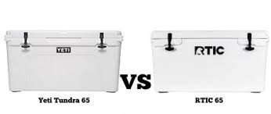
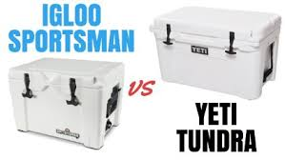
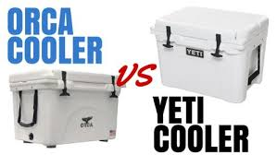
The Competition*
RTIC
Reviews are very similar for RTIC as compared to YETI, but lower pricing (plus no revenue figures)
IGLOO
Older brand (founded 1947) that many customers are loyal to and has grown a large market share
ORCA
Lower reviews and low market share, but new licenses with the NFL signal potential growth
*There are many others, this market is very large!

Slide 6
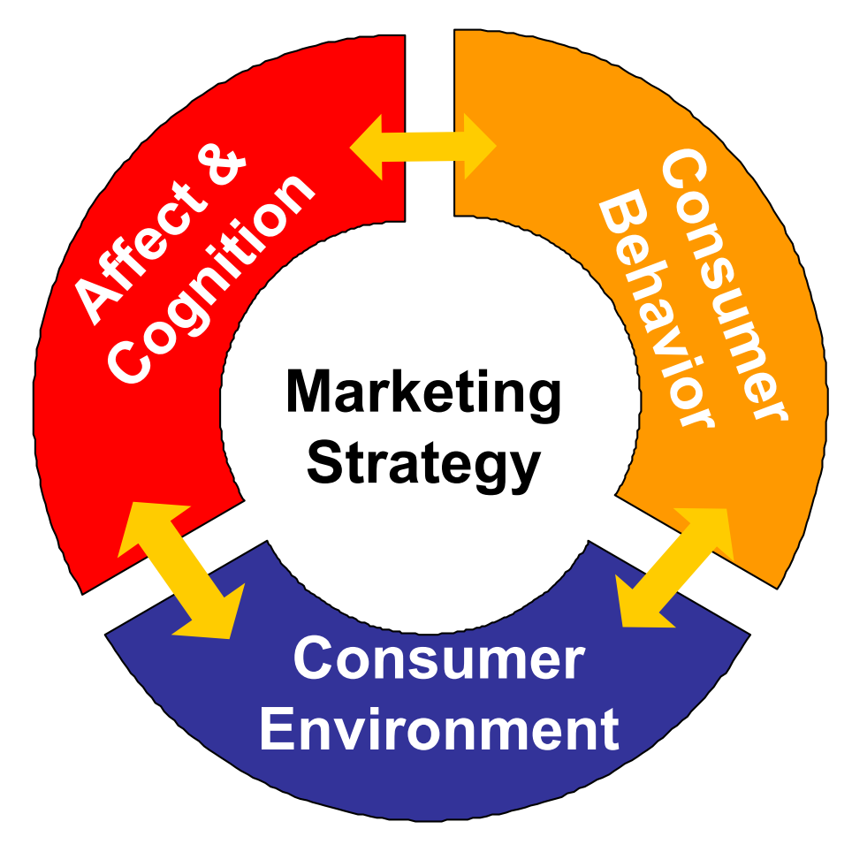
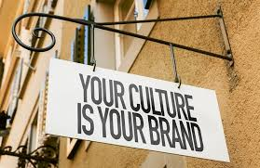
The Marketing Strategy

Slide 7
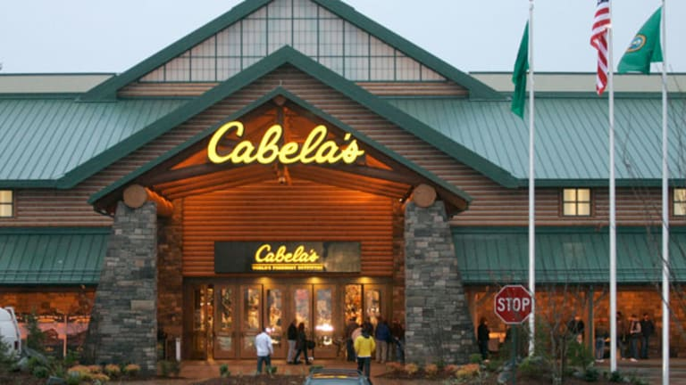
Consumer Environment*
*Likely the most important aspect of the wheel of consumer behavior for YETI!
Social environment:
Made of very close-knit communities of fishermen, hunters, barbecuers, etc.
More likely to buy when they are exposed to the brand often by social proof, either through friends or the brand ambassadors they might follow that have the products
Environmentally friendly company and products (having a reusable mug or rambler is already a huge sustainable step) which focuses on the macrotrend of being green and sustainable
Physical Environment:
Mainly outdoors stores such as Cabela’s
Their own brick and mortar stores (5)
Online store

Slide 8

Consumer Affect and Cognition
Usually a customer would be a single buyer with high involvement decision making
YETI targets itself as high-end and their prices are higher than their competitions’
Because of the high price, customers are probably going to need to be in a cold state while purchasing from this company
Customers looking to have the best quality might feel like YETI would be their best option, outweighing price
Due to YETI’s concern for nature, customers might think that purchasing from this brand helps them to also be environmentally conscious

Slide 9
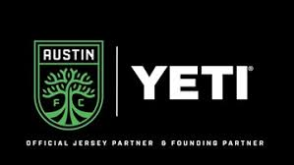
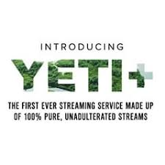
Success in Brand Building
Active in outdoors communities
Partnering with sports leagues and organizations important to their customers
Finding unique ways to connect customers with nature
YETI+ “streaming” site that shows live footage to streams to promote being able to enjoy nature while quarantining
Frequent deals to combat criticism of high pricing

Slide 10

Time for a change?

Slide 11
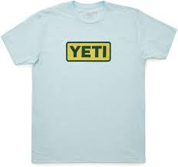
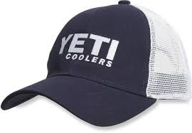
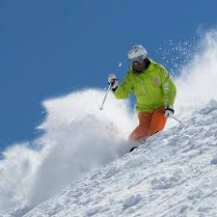
Recommendation 1: Expand Apparel Line
Break further into the apparel market, beyond hats and t-shirts, to create items such as pants and jackets
Strong equity as evidenced by entry into non-cooler and other apparel markets
Could be done solely through YETI, or the brand could partner with other clothing manufacturers
YETI apparel would appeal to their current market of outdoors enthusiasts/fishermen and hunters
YETI’s previous products insulate for hot and cold, logical fit for apparel
Winter sporting designed for outdoor activities, such as skiing and snowboarding, could help YETI in increasing their span to other sports-related markets

Slide 12
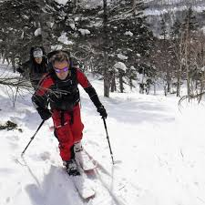
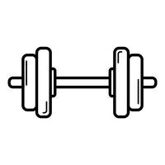
Recommendation 1: Reasoning and Rationale
Applying the idea of consistency, current customers are likely to also purchase apparel, to stay consistent with the brand they choose for outdoor supplies
The current affect and cognition related to the YETI brand and is based around feelings of positivity and trust, which would give consumers confidence in the quality of YETI’s new apparel
Their perception of durability would extend into their apparel line
YETI is also in a good financial position to expand

Slide 13
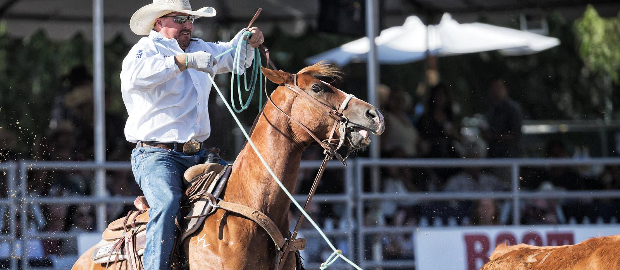
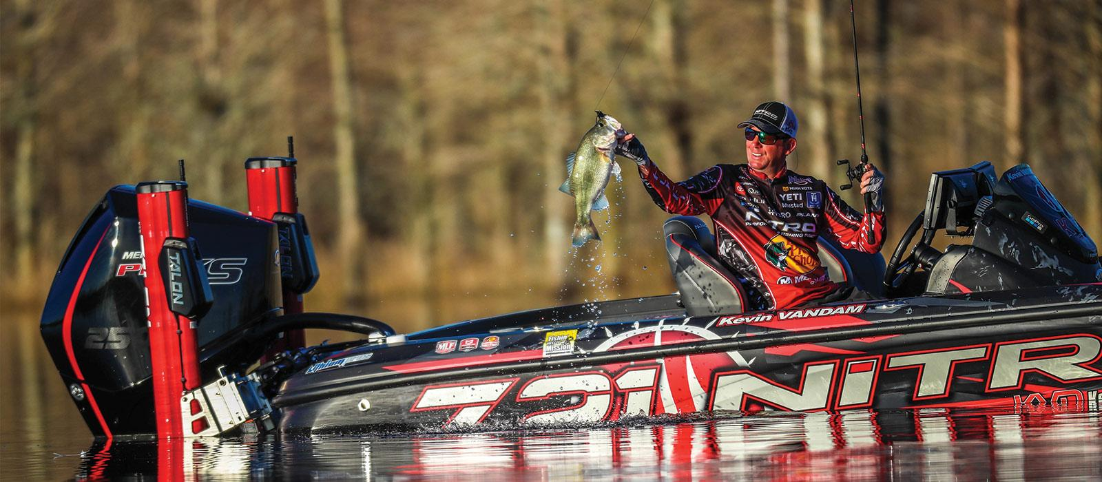
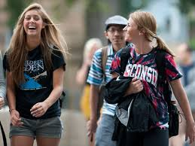
Recommendation 2: College Lifestyle Ambassadors
The current demographic of YETI ambassador pool is comprised of professional outdoor and extreme sports athletes
Older aged outdoor enthusiasts may connect with current ambassadors, but YETI’s younger consumers may not relate
Introducing college-aged lifestyle influencers into the ambassador program could attract students to the YETI brand

Slide 14
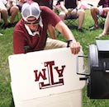

Recommendation 2: Reasoning and Rationale
Based on the concept of social proof, college-aged students would choose to purchase items from YETI if they see similar aged influencers also using the brand’s products
The addition of younger lifestyle ambassadors helps to change college students affect and cognition of the YETI brand
Develop feelings of comfort for the high-quality brand.
No longer just associate YETI with intense outdoor enthusiasts

Slide 15


Recommendation 3: Student Discount
YETI should offer a discount on their rambler and tumbler line to college students
(Not just because we would really appreciate it!)
College students are typically price-sensitive customers
YETI’s customers tend to remain brand loyal
Introducing YETI products to students encourages future purchases from them when income is stable
Capitalizes on coffee trend among college-age adults

Slide 16
Recommendation 3: Reasoning and Rationale
More students see YETI in their social environment, raising brand awareness
Purchasing YETI’s products has a high decision threshold due to high prices
Discount reduces decision threshold for students
Plan aligns with future macro trends of reduced spending
In recessions, people are less willing to purchase luxury goods at full price
More likely to bargain hunt and wait for sales before making purchases

Slide 17
References
https://thecoolerbox.com/who-is-yetis-biggest-competitor/
https://www.kvue.com/article/news/local/austin-fc-yeti-central-texas-food-bank-food-drive/269-a0bee566-490c-4269-bcbd-4e15bd50f05c
https://adage.com/article/cmo-strategy/high-priced-yeti-coolers-aspirational-brand/295243
https://www.washingtonpost.com/news/morning-mix/wp/2018/04/24/nra-supporters-are-blowing-up-yeti-coolers-yeti-says-its-all-a-big-mistake/
https://stories.yeti.com/ambassadors
https://stories.yeti.com/story/our-story
https://www.yeti.com/en_US/partners.html
https://www.yeti.com/en_US/yeti-plus.html
https://www.yeti.com/en_US/yeti-store-locations.html
https://www.yeti.com/en_US/apparel
https://www.inc.com/magazine/201602/bill-saporito/yeti-coolers-founders-roy-ryan-seiders.html
https://www.yeti.com/en_US/home

